Slide 1

Digital Signal Processing
Course Instructor
Dr. Ali J. Abboud
Lecture No. 3: Discrete Time Systems
Third Class
Department of Computer and Software Engineering
http://www.engineering.uodiyala.edu.iq/
https://www.facebook.com/Engineer.College1

Slide 2
Lecture Outline
Classification of Discrete Time Systems (DTS)
Basic Operations on Signals
Describing Digital Signals with Impluse Function
Dr. Ali J. Abboud

Slide 3
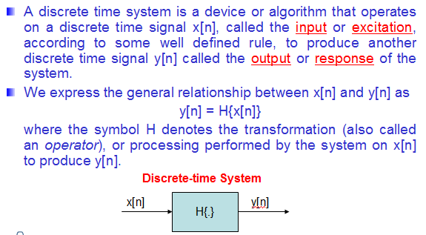
Discrete Time Systems (DTS)
Dr. Ali J. Abboud

Slide 4
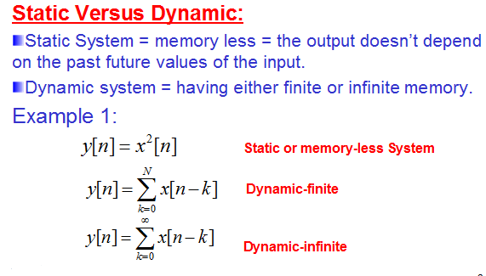
Classification of Discrete Time Systems (DTS)
Dr. Ali J. Abboud

Slide 5
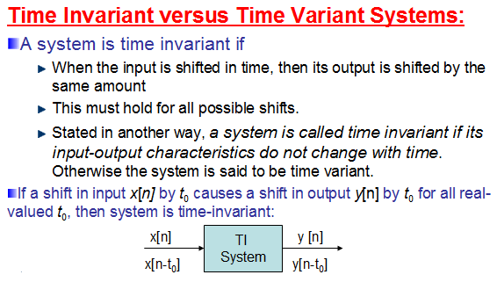
Classification of Discrete Time
Systems (DTS)
Dr. Ali J. Abboud

Slide 6
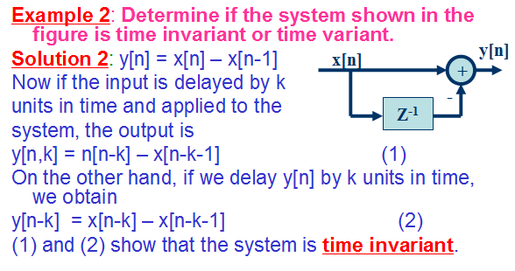
Classification of Discrete Time
Systems (DTS)
Dr. Ali J. Abboud

Slide 7
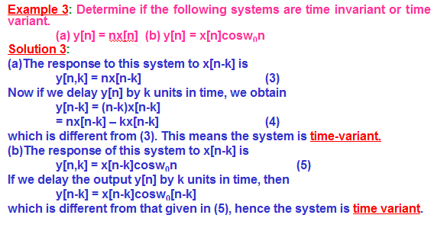
Examples
Dr. Ali J. Abboud

Slide 8
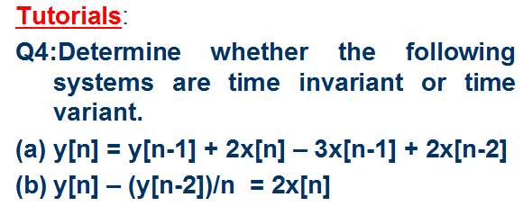
Classification of Discrete Time Systems (DTS)
Dr. Ali J. Abboud

Slide 9
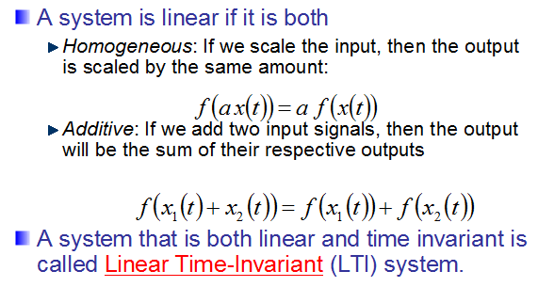
Linearity
Dr. Ali J. Abboud

Slide 10
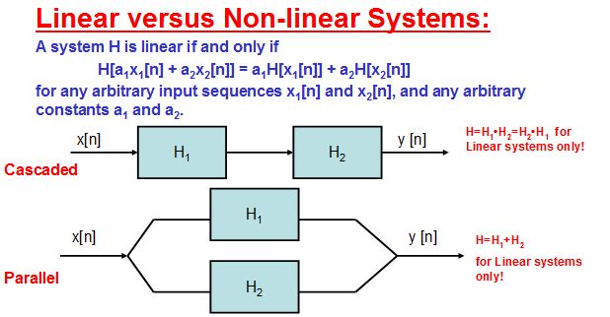
Classification of Discrete Time Systems (DTS)
Dr. Ali J. Abboud

Slide 11
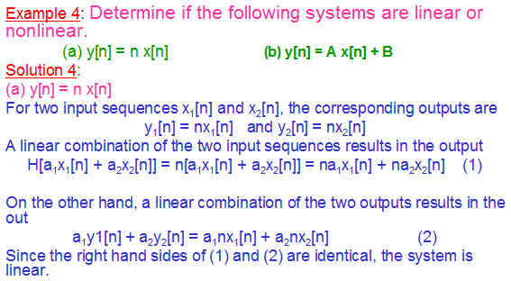
Examples
Dr. Ali J. Abboud

Slide 12
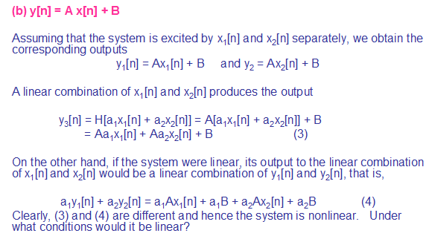
Examples
Dr. Ali J. Abboud

Slide 13
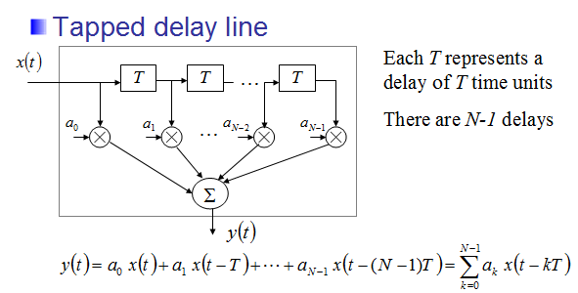
Examples
Dr. Ali J. Abboud

Slide 14
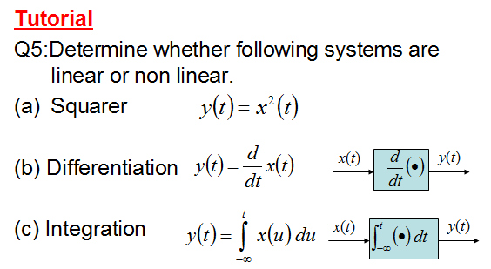
Tutorial
Dr. Ali J. Abboud

Slide 15
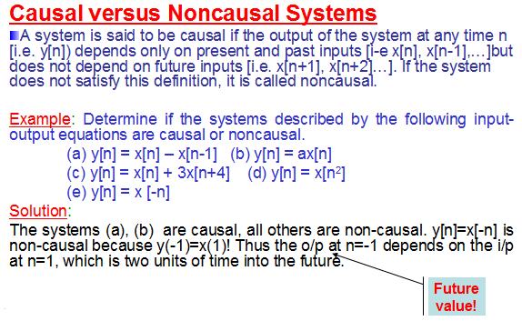
Classification of Discrete Time Systems (DTS)
Dr. Ali J. Abboud

Slide 16
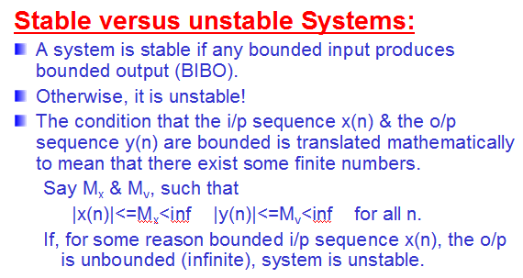
Classification of Discrete Time Systems (DTS)
Dr. Ali J. Abboud

Slide 17
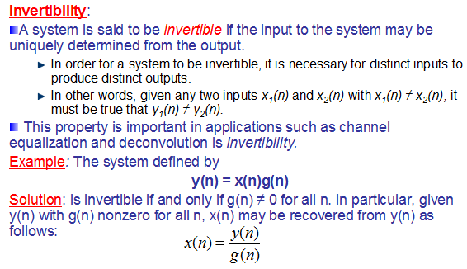
Classification of Discrete Time Systems (DTS)
Dr. Ali J. Abboud

Slide 18
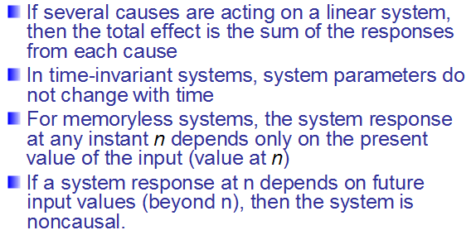
Summary
Dr. Ali J. Abboud

Slide 19
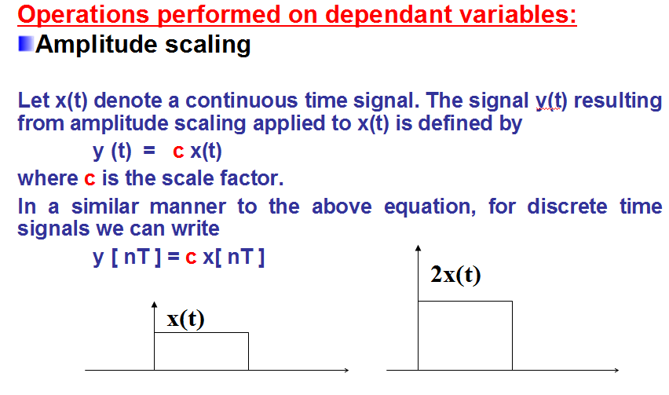
Basic Operations on Signals
Dr. Ali J. Abboud

Slide 20
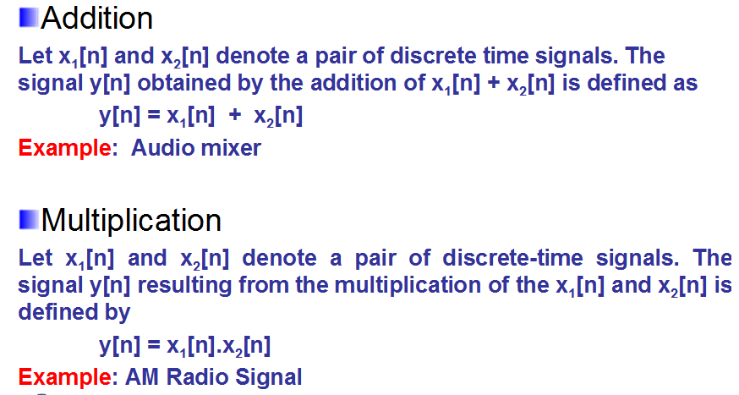
Basic Operations on Signals
Dr. Ali J. Abboud

Slide 21
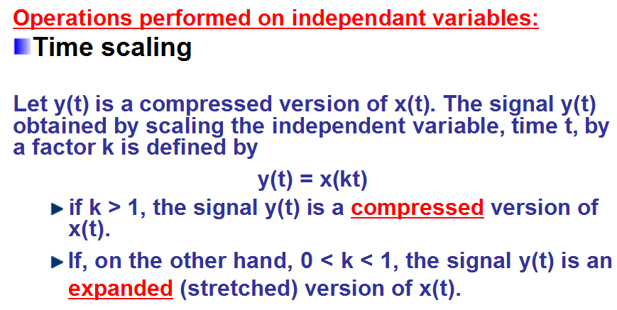
Basic Operations on Signals
Dr. Ali J. Abboud

Slide 22
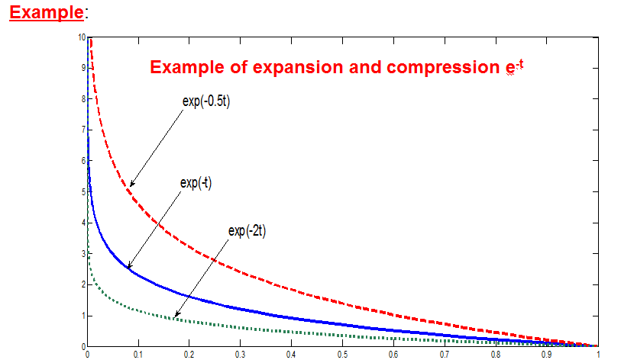
Basic Operations on Signals
Dr. Ali J. Abboud

Slide 23
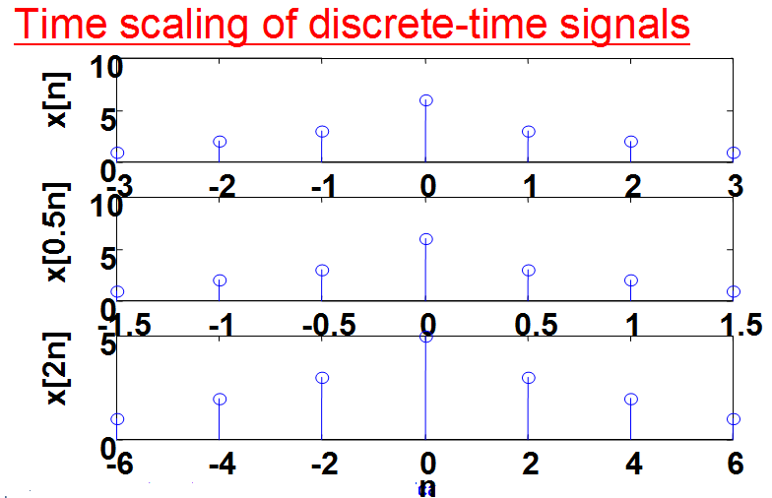
Basic Operations on Signals
Dr. Ali J. Abboud

Slide 24
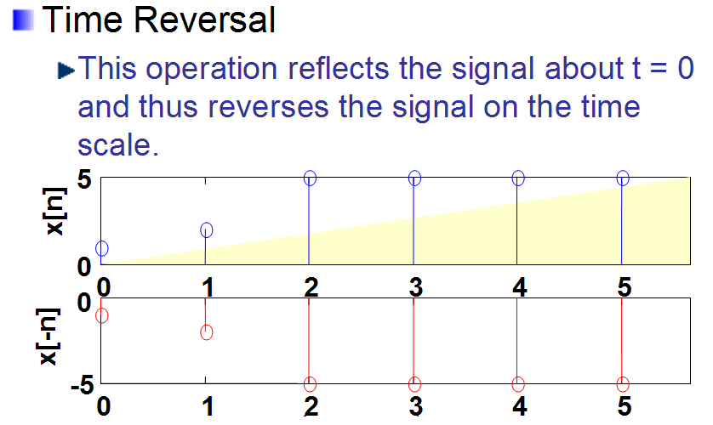
Basic Operations on Signals
Dr. Ali J. Abboud

Slide 25
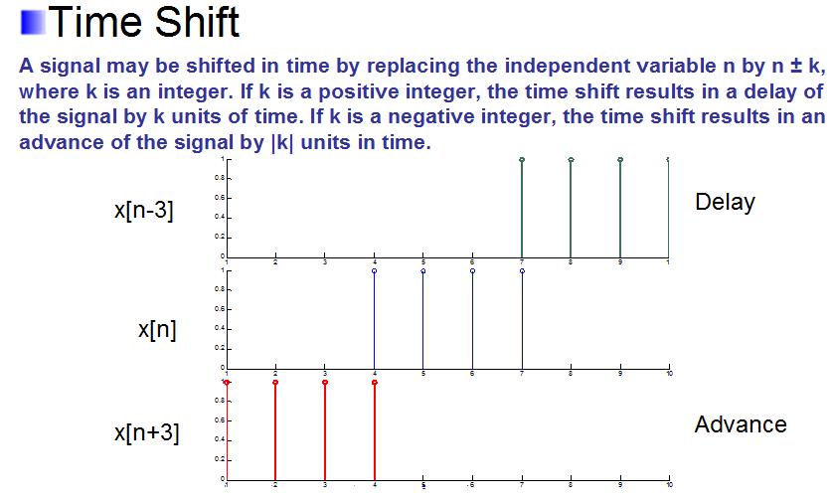
Basic Operations on Signals
Dr. Ali J. Abboud

Slide 26
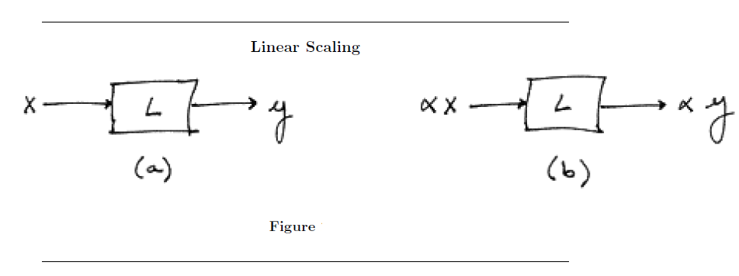
Linear Time-Invariant (LTI) Systems
Linear Systems
Dr. Ali J. Abboud

Slide 27
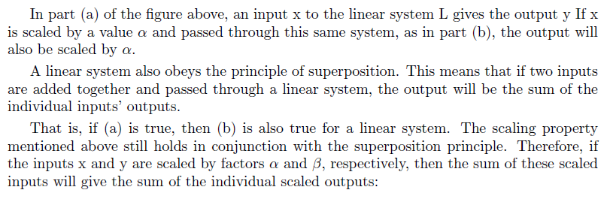
Linear Time-Invariant (LTI) Systems
Linear Systems
Dr. Ali J. Abboud

Slide 28
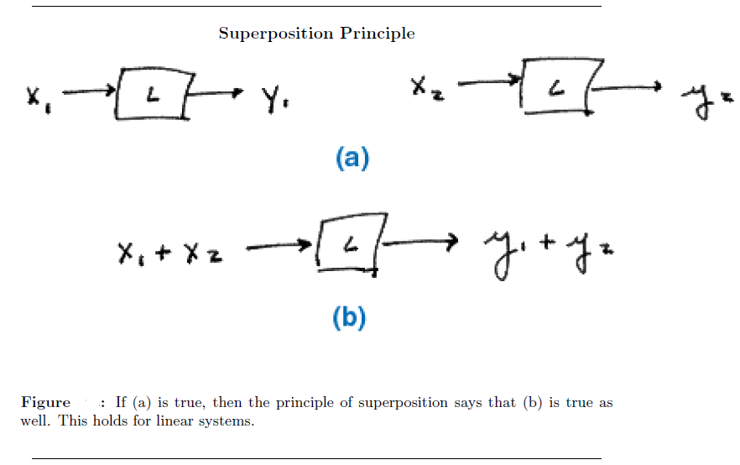
Linear Time-Invariant (LTI) Systems
Linear Systems
Dr. Ali J. Abboud

Slide 29
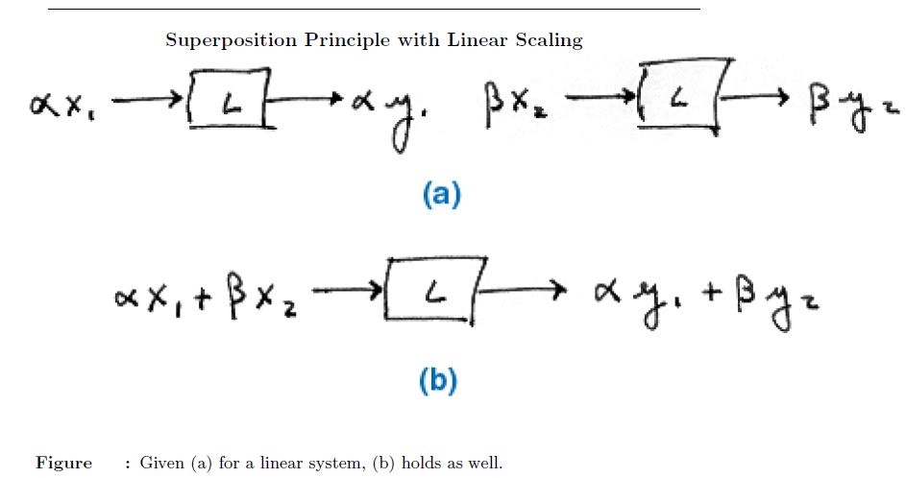
Linear Time-Invariant (LTI) Systems
Linear Systems
Dr. Ali J. Abboud

Slide 30
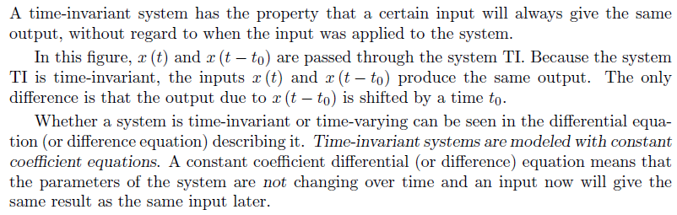
Linear Time-Invariant (LTI) Systems
Time-Invariant Systems
Dr. Ali J. Abboud

Slide 31
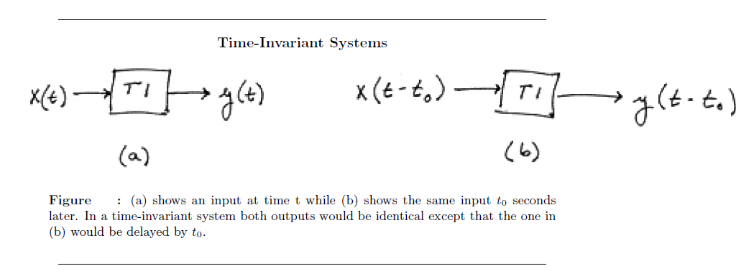
Linear Time-Invariant (LTI) Systems
Time-Invariant Systems
Dr. Ali J. Abboud

Slide 32
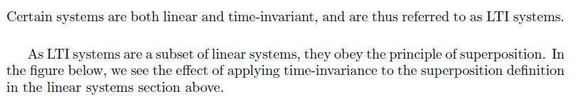
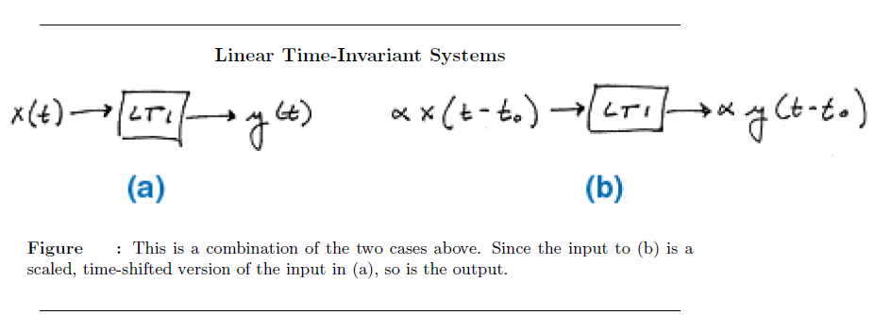
Linear Time-Invariant (LTI) Systems
Dr. Ali J. Abboud

Slide 33
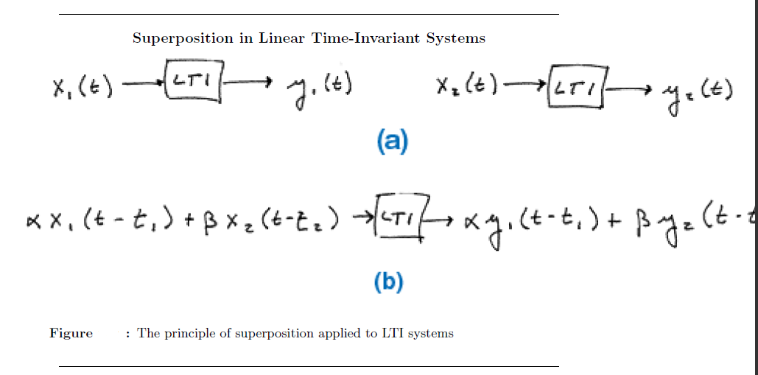
Linear Time-Invariant (LTI) Systems
Dr. Ali J. Abboud

Slide 34
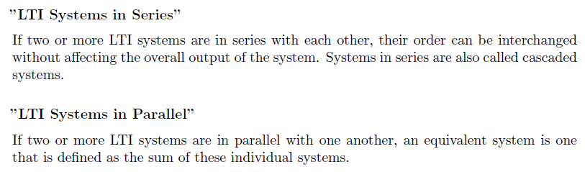
Linear Time-Invariant (LTI) Systems
Dr. Ali J. Abboud

Slide 35
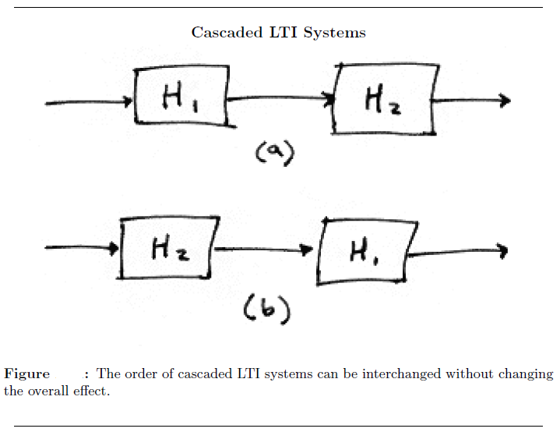
Linear Time-Invariant (LTI) Systems
Dr. Ali J. Abboud

Slide 36
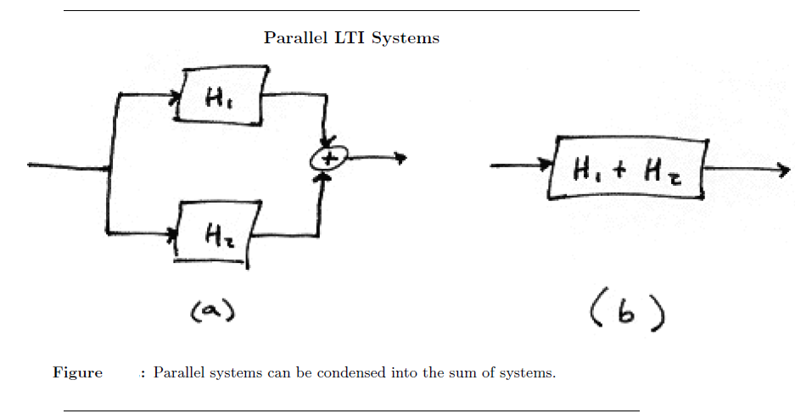
Linear Time-Invariant (LTI) Systems
Dr. Ali J. Abboud

